Slide 1
Data Structures
Lecture 11
Tree
Prantik Paul [PNP]
Lecturer
Department of Computer Science and Engineering
BRAC University

Slide 2
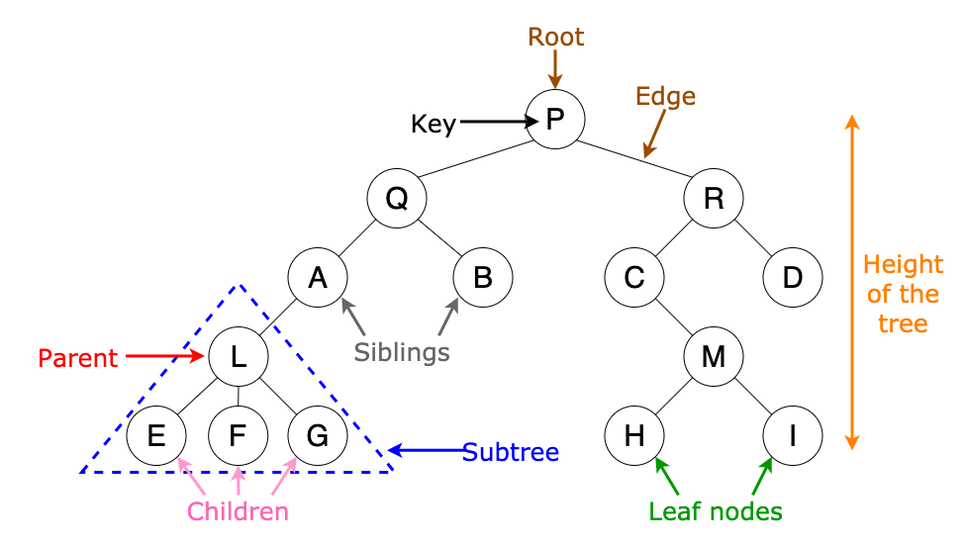
Trees

Slide 3
Why Trees?
Sorting New Elements
Folder/File System Structure
Computer Network Algorithms

Slide 4
Trees - Root/Leaf/Non-Leaf

Slide 5
Trees - Parent/Child/Siblings

Slide 6
Trees - Edge/Path
n nodes → n-1 edges

Slide 7
Trees - Degree

Slide 8
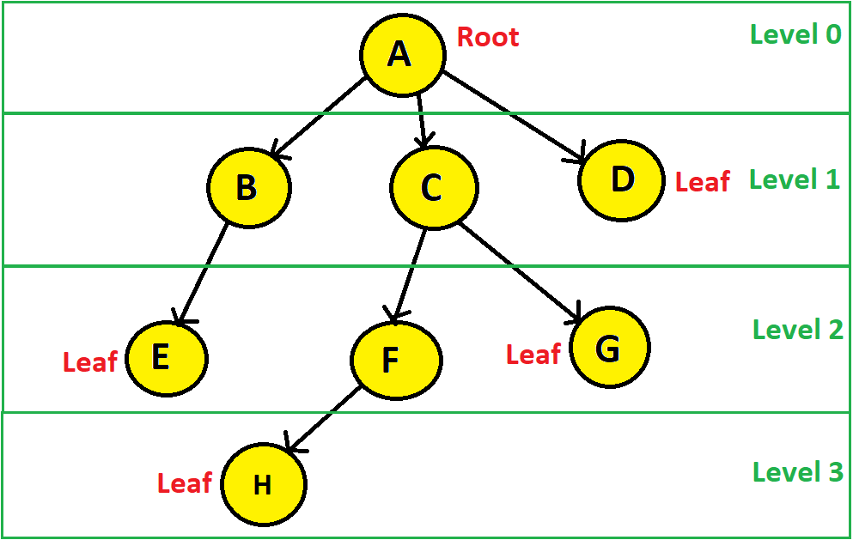
Trees - Depth/Height/Level

Slide 9
Trees - Depth/Height/Level
Depth of A?
Height of A?
Depth != Height
Depth = Level

Slide 10
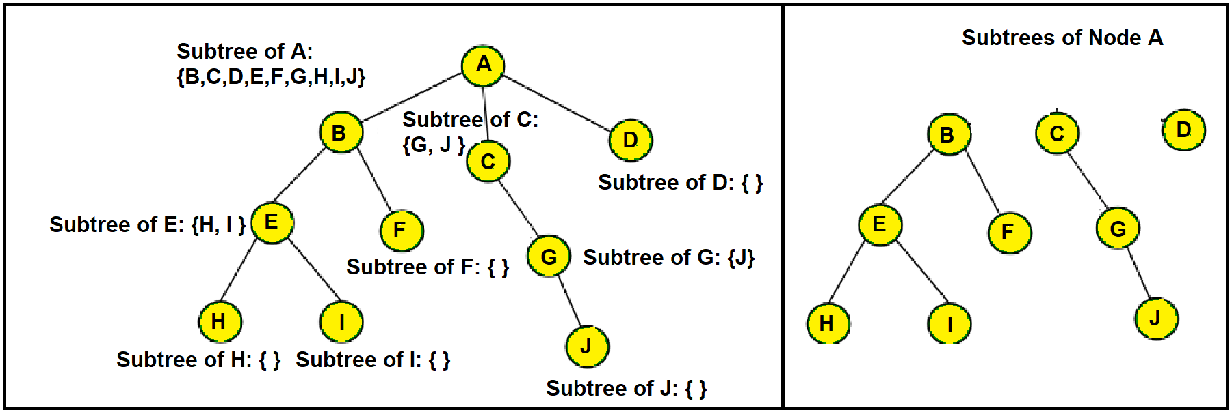
Trees - Subtree

Slide 11
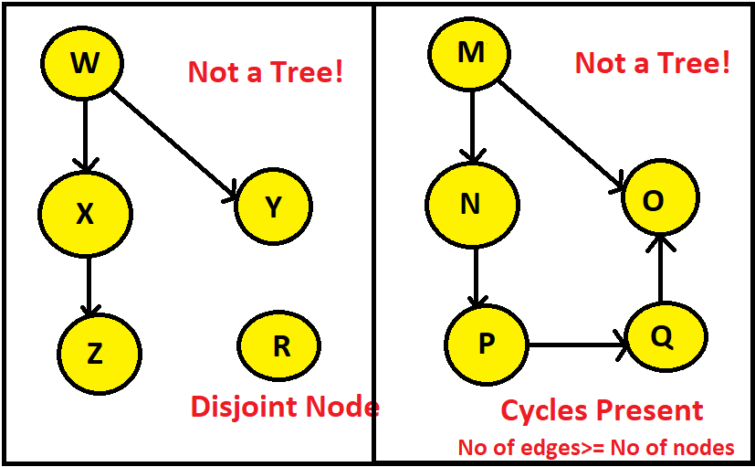
Trees - Characteristics

Slide 12
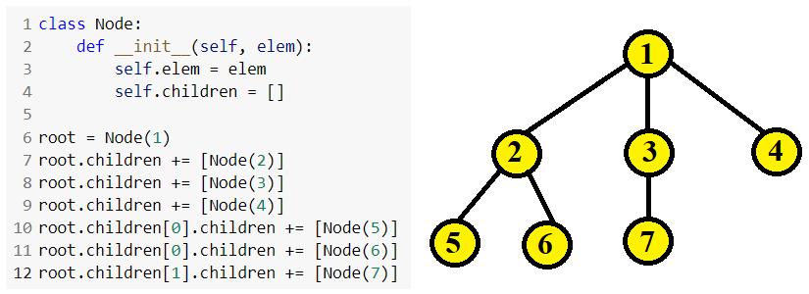
Trees - Build a Tree
Dynamic Representation with Linked List
Sequential Representation with Array

Slide 13
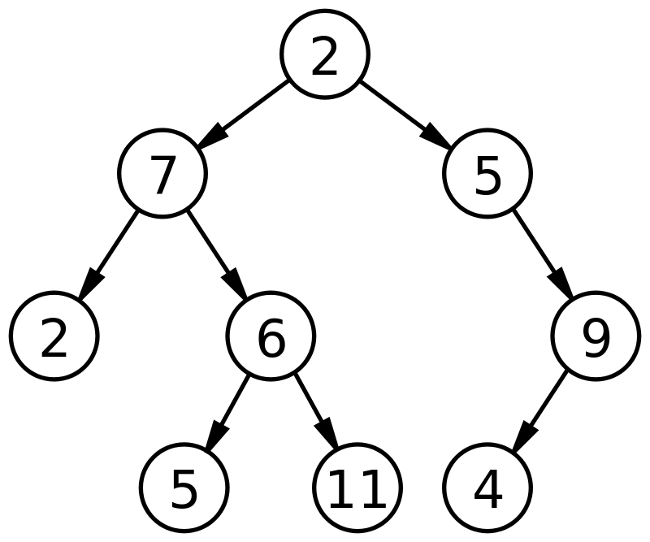
Binary Trees

Slide 14
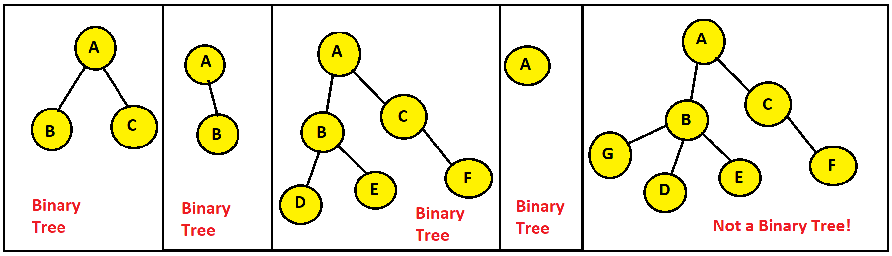
Binary Trees

Slide 15
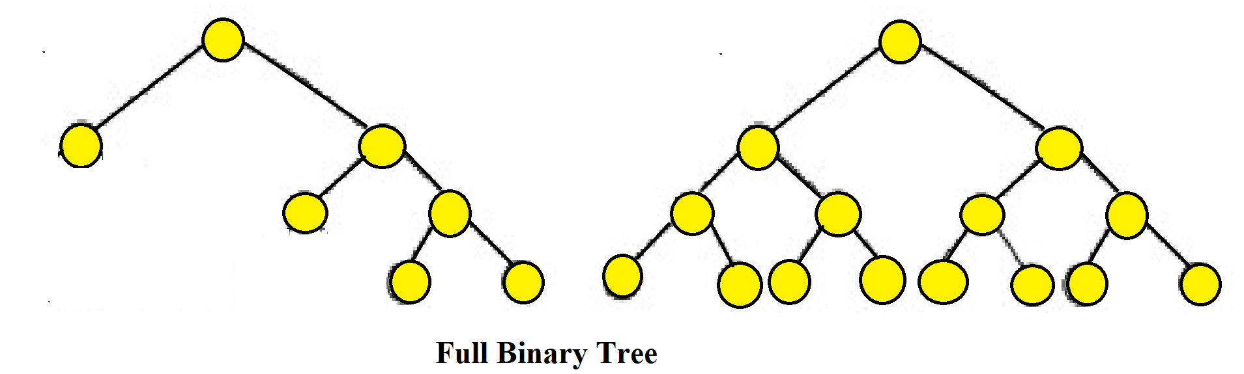
Binary Tree - Full/Strict Binary Tree
No of leaf nodes = no of internal nodes + 1

Slide 16
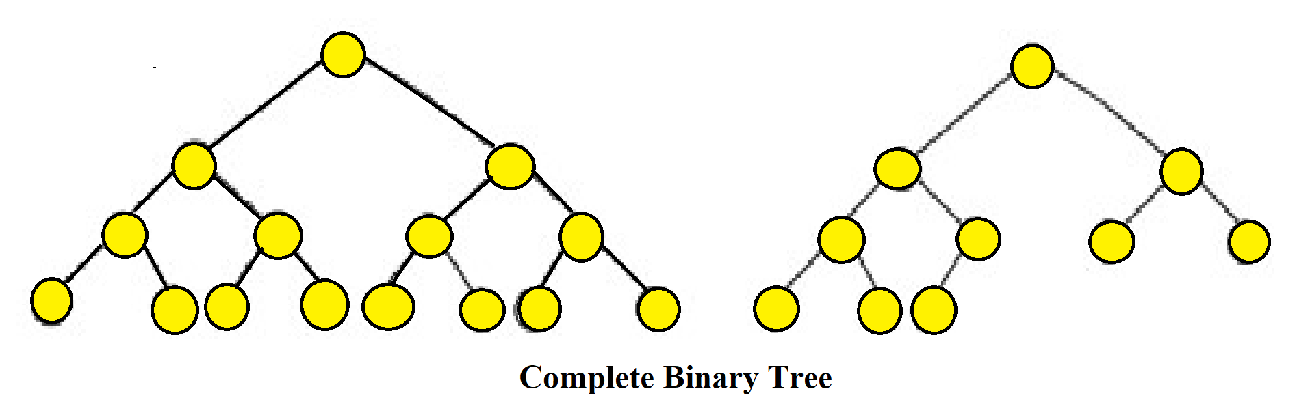
Binary Tree - Complete Binary Tree
All levels filled starting from LEFT

Slide 17
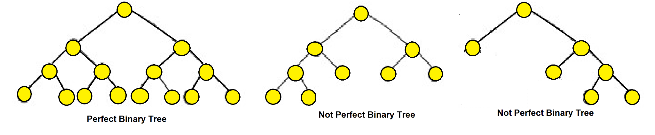
Binary Tree - Perfect Binary Tree
All Internal Nodes have 2 child
All Leaf Nodes at same Level

Slide 18
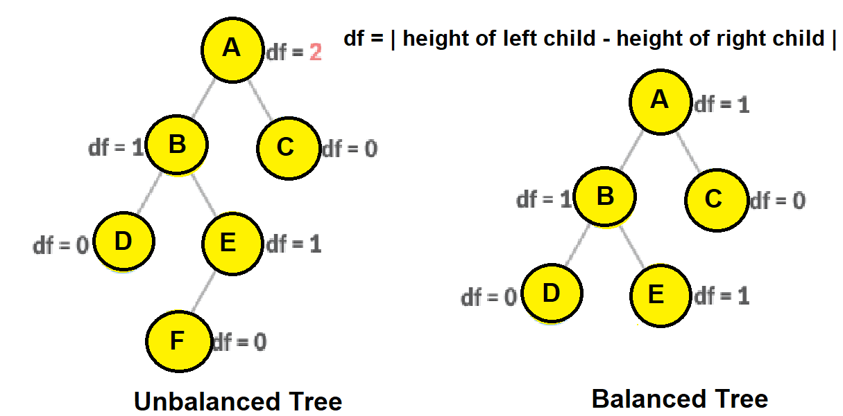
Binary Tree - Balanced Binary Tree
| height(left) - height(right) | <= 1

Slide 19
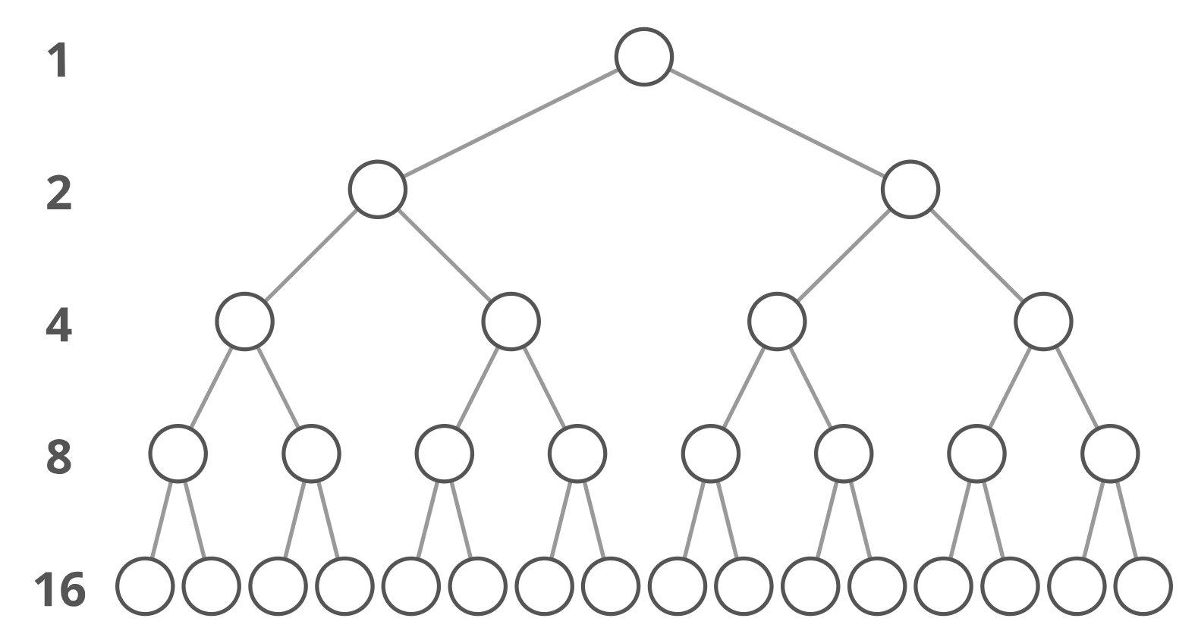
Binary Trees - Characteristics
The maximum number of nodes at level i is: 2^{i}

Slide 20
Binary Trees - Characteristics
The maximum number of nodes possible in a binary tree of height ‘h’ is: 2^{h+1} – 1

Slide 21
Binary Trees - Characteristics
Number of internal nodes : n
Number of external nodes : n+1

Slide 22
Binary Trees - Characteristics
Number of internal nodes : n
Number of internal edges : n-1

Slide 23
Binary Trees - Characteristics
Number of internal nodes : n
Number of external edges : n+1

Slide 24
Binary Trees - Characteristics
Number of internal nodes : n
Number of edges : 2n

Slide 25
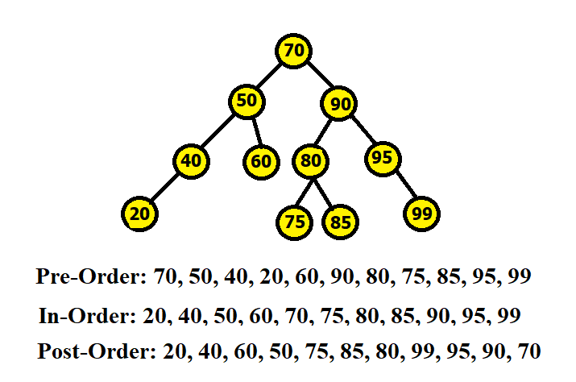
Binary Trees - Traversal (Pre-order)

Slide 26
Binary Trees - Traversal (In-order)

Slide 27
Binary Trees - Traversal (Post-order)

Slide 28
Binary Trees - Array Representation
If the height of the binary tree if h, An array of maximum 2^{h+1} length is required
The root is placed at index 1
Any node that is placed at index i, will have its left child placed at 2i and its right child at 2i+1

Slide 29
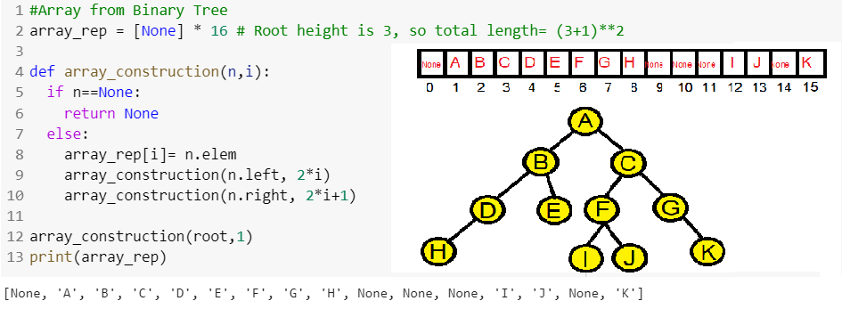
Binary Trees - Array Representation

Slide 30
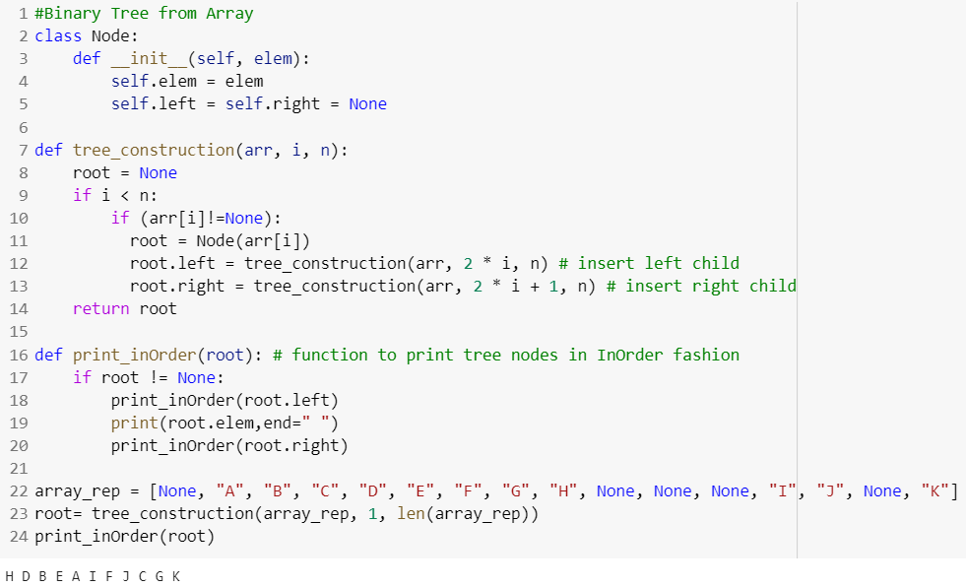
Binary Trees - Tree Node

Slide 31
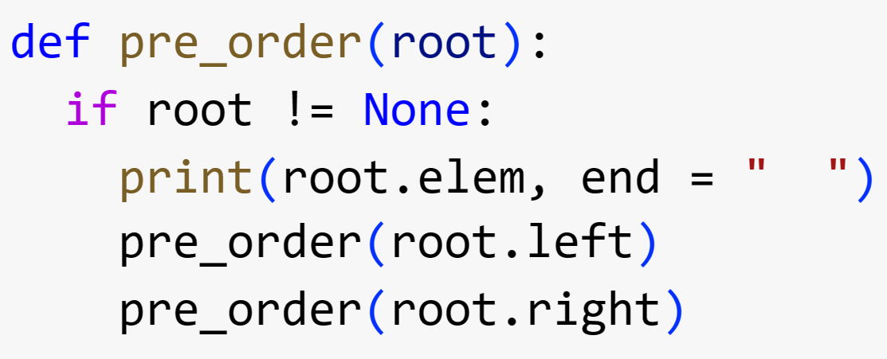
Binary Trees - Preorder Traversal

Slide 32
Binary Trees - Inorder Traversal
Left → print(root.elem) → Right
Do yourself

Slide 33
Binary Trees - Postorder Traversal
Left → Right → print(root.elem)
Do yourself

Slide 34
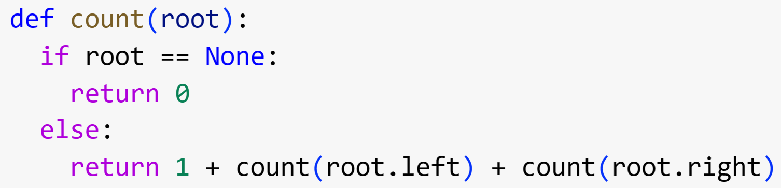
Binary Trees - Count Nodes of Tree

Slide 35
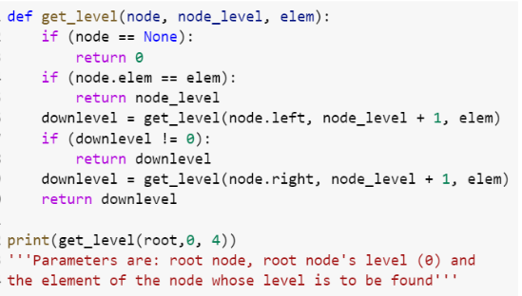
Binary Trees - Find Level of a Node

Slide 36
Binary Trees - Find Height of a Node
If node is None
return -1
else
return 1 + max(left_subtree_height, right_subtree_height)
Do yourself

Slide 37
Binary Trees - Build Tree From Array

Slide 38
Binary Trees - Build Array From Tree

